Slide 1

CSRF token
3g5yFQRwZPgA0850vq5dzZgUafCwuHgwx6lzql1VDXxQcDHBRzQCUvwFxZQOvbzA

Slide 2
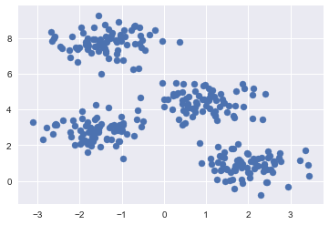
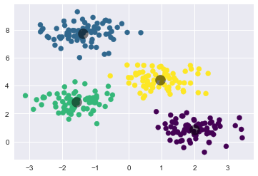
KMeans
1. Run the Kmeans algorithm
->
2. Repeat 10 times and decide on the best one based on the cluster with the lowest size. If after 10 iterations, there is still a cluster with a size < 5, the best option is the one with the least amount of points in such clusters. Assign those points to nearest clusters
3. Run Kmeans on every cluster with a size > 15

Slide 3
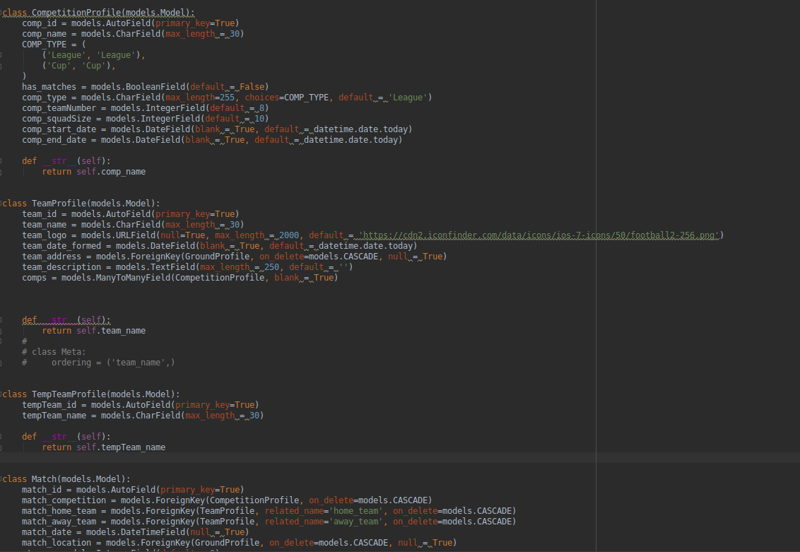
Database:

